Slide 1
DNA Damage Repair Subtypes in Serous Ovarian Cancer
Courtney Vaughn, Isaac Robson, Kentaro Hoffman, and John Sperger

Slide 2
Motivation
Given that Platinum- based chemotherapies act by damaging DNA, it is assumed that tumor cells that have better repair efficiencies. We will test this hypothesis by creating clusters of tumor samples based on DNA damage response gene expression and looking for differences in survival between the clusters.

Slide 3
Data
There are RNA-Seq samples for 376 cases in the available data for the TCGA-OV project all have clinical data
The DNA Damage Response (DDR) gene set was retrieved from the Gene Ontology Consortium. The TCGA-OV RNA-Seq data contained 808 out of the 830 genes in the ontology.
TCGA-OV Gene list provided by Katie (thanks!)

Slide 4
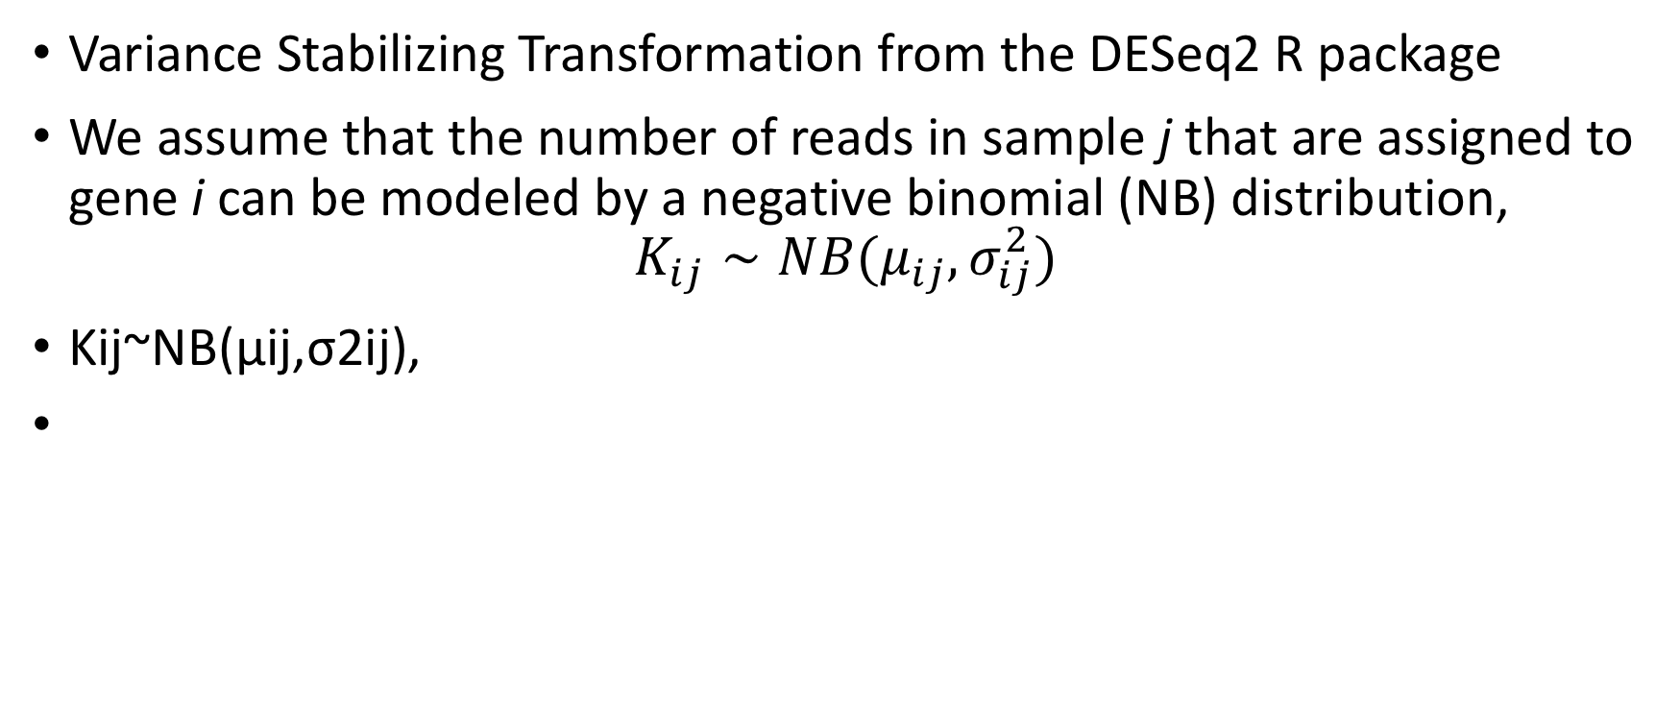
Preprocessing
Variance Stabilizing Transformation from the DESeq2 R package
We assume that the number of reads in sample j that are assigned to gene i can be modeled by a negative binomial (NB) distribution,
$$K_{ij}∼NB(μ_{ij}, σ_{ij}^{2})$$
Kij~NB(μij,σ2ij),

Slide 5
NMF
Kernel K-means clustering
Laplacian-matrix based spectral clustering

Slide 6
DCM

Slide 7
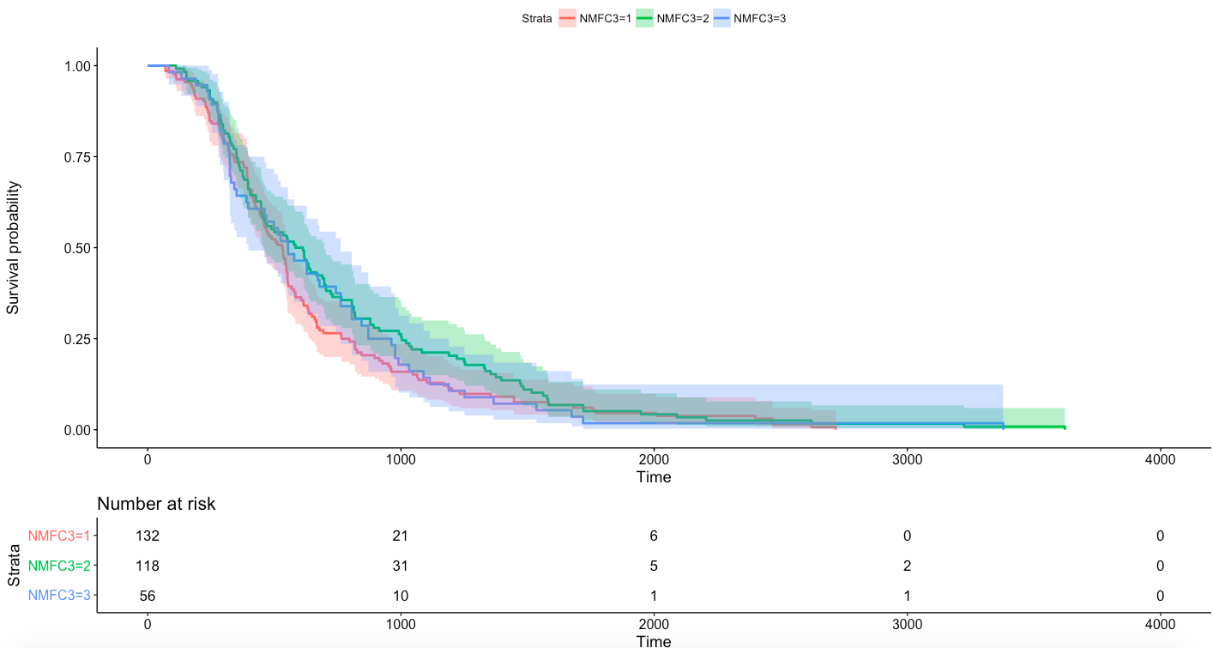

Survival Outcomes for DFC Clustering
Kaplan-Meier Plots hints at cluster 1 having worse outcomes
But Cox Regression fails to indicate any significant difference in survival outcomes between the clusters

Slide 8
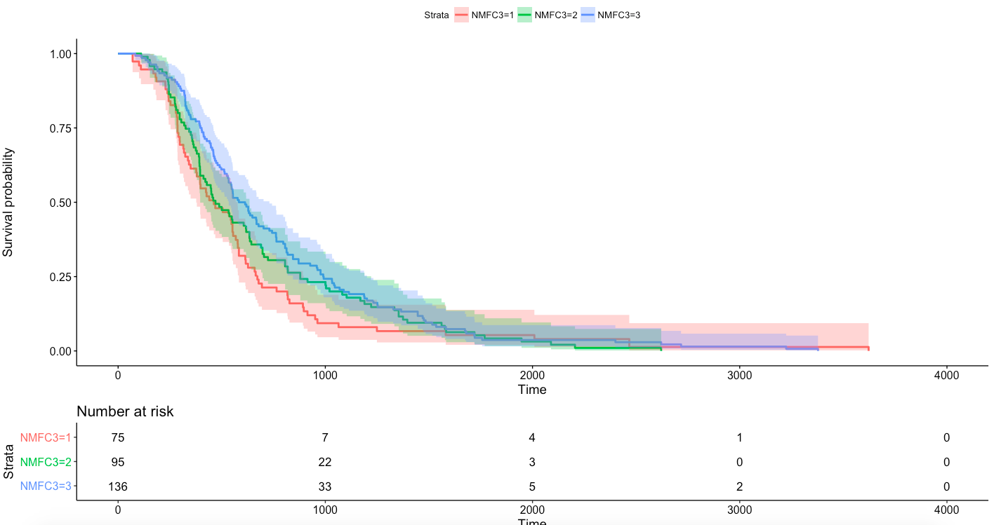

Survival Outcomes for NMF Clustering
This time, both KM and cox regression find that cluster 1 is significantly different at least from cluster 3.
This points to (at least in terms of survival) some kind of robustness in clustering

